Slide 1
The best way to find out if you are secure is to try to break in yourself
Daniel Deng
IT Specialist 1.5y
Customer Relationship Management (CRM) 5Y
Construction 2Y
Notes:
During the boot camp, I developed a strong interested in proactively enhancing security posture to defend cyber-attacks, and I believe penetration testing is one of the best ways to achieve this.
I am pleased to share my insight today

Slide 2
Summary
February 19, 2022, web server under attacked
Attackers accessed database via lateral movement
Sensitive client PII breached
Confidentiality of CIA framework compromised
The key point of compromise: Web Server
Notes:
Attackers accessed database through lateral movement since we do not have network segmentation in place and our password policy is weak
Result: Sensitive client data breached.
Looking back on this incident: the key point of compromise is Our Web Server since it is public-facing and prone to all kind of cyber threat. Therefore we need enhance websever’s security posture. There are many ways to defend our web server, we can use WAF, host-based IDS/IPS, However, I do think a penetration test is the best option

Slide 3
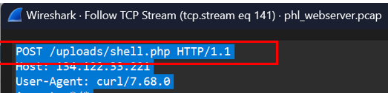
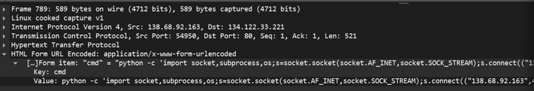
Highlight
Attacker discovered backdoor on our server
Executed a Python script to establish a reverse shell
Gained remote control and access to the server
shell.php backdoor
Notes:
During the reconnaissance scan. The attacker was able to find a backdoor vulnerability in our server, shell.php, then the attack executed a python script to start a reversed shell connection to gain remote access to our web server through this backdoor

Slide 4

Highlight
Outdated Server: Version 2.4.41
Apache/2.4.41 was outdated by February 2022 (The time of this incident). This version of Apache was released in August 2019 (Ruggeri, 2019), and by 2020, several security vulnerabilities had been identified and patched in later releases.
CVE-2020-11984
CVE-2020-13950
Shell.php file detected with no PUT method found in logs. This backdoor may have been present in our web server for an extended period.
Notes:
How exactly did the attack find this vulnerability in our server? Based on my analysis. if we go to the websever PCAP file in Wireshark, we can see our server ‘s version is 2.4.41. this is released in August 2019 and outdated in 2020 since multiple vulnerabilities have been announced during 2020 by National Vulnerability Database (NVD). Unfortunately, we did not patch our server.
To me, the outdated server is the reason of server compromise. Our webserver log file did show any evidence of this file shell.php being uploaded during the attack because there is no PUT request in our webserver logs, so I suspect this backdoor was lurking on our web server for a long time.
But the important thing is we need to be able to identify this backdoor vulnerability before the attacker does. How? That is through penetration testing

Slide 5
Penetration Testing
A penetration test, or "pen test," is a manually security test that launches a mock cyberattack to find vulnerabilities in a computer system
A vulnerability scan is an automated, high-level test that looks for and reports potential known vulnerabilities. A penetration test is a detailed hands-on (Manually) examination by a real person that tries to detect and exploit weaknesses in your system.
shell.php Backdoor can be easily identified through web app penetration test
Question: Can we just rely on network/endpoint monitoring to mitigate threat?
Notes:
According to IBM Pen test is….. this is not to be confused with a vulnerability scan
A scan is an automated, high-level test that looks for potential known published vulnerabilities, while pen test focus on manually identify the flaws in the system, it will reduce the false positives and may find new vulnerabilities compare to the scan
especially in our case, this malicious file shell.php is a very common backdoor file used by attacker to remote access to a compromised server. During the penetration test, this file can be easily identified.
A vulnerability scan may identify our server is outdated, but it may not find the backdoor file depending on how the scan is configured

Slide 6
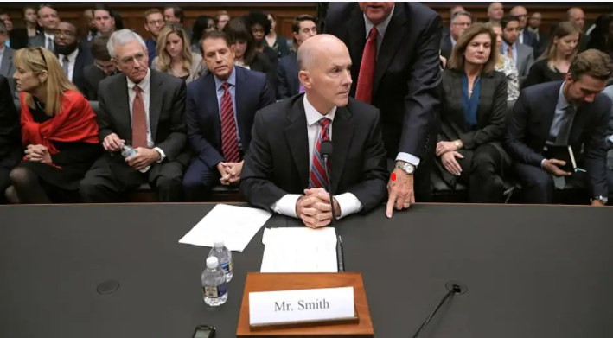
Equifax CEO Richard F. Smith in hearing(2017)
Direct Costs (Settlement, Legal, and Remediation): Around $1.4 billion to $2 billion.
Market Value Loss: Around $4 billion in lost market capitalization immediately.
Penetration Tests and VA scan could have prevented this data breach.
Notes:
This incident reminds of another cyberattack in 2017, the Equifax data breach, it cost the company almost total 6 billion dollars not including reputation damage.
This incident is very similar to our data breach

Slide 7
Cause
Solution
A failure to patch a known vulnerability in a widely used web application framework, Apache Struts
CVE-2017-5638(March 7, 2017)
Attackers began exploiting on
May 13, 2017
Attackers remained in Equifax's network for 76 days
July 29, 2017- Equifax discovered “suspicious network traffic”
Active Manual Penetration Testing
And Vulnerability Scan
At least Quarterly For External Pen Test
Annually for Internal Pen Test
Answer: We can not just rely on network/endpoint monitoring
Not Enough
Notes:
Equifax was using an outdated web app framwork call Apache Struts. The NVD published this vulnerability on March 7, 2017, until the attack happened on May 13 which is two months later, Equifax has not patched this
Their security team discovered the suspicious network traffic on July 29, which is more than 2 months later when the attack happened, but by then it is already too late, The attackers stayed in Equifax's network for 76 days and stole 146 millions record.
This is just to show that we can not just rely on network or endpoint monitoring to mitigate threat, by the time we see suspicious activity, it might be too late, we need conduct Regular penetration test to enhance a company’s security posture.

Slide 8
Next Step
Penetration tests should be conducted manually every quarter by an approved third-party or internal security team.
Performing a monthly vulnerability scan on the organization's systems to detect known vulnerabilities, including outdated software, configuration errors, and missing security patches.
A $200,000 vs $6,000,000,000 Question
Notes:
Based on this incident, we should update our security policies, we need to conduct manual pen tests each quarter and automated scan each month.
With These two policies in place, it will increase our confidence to defend more complex cyber threats.
Yes, we all know that it is expensive, a regular pen test for a large organization can cost more than 200.000 dollars, BUT to be Honest. Would you Rather take on the risk of losing 6 billion dollars over a 200.000 pen test?

Slide 9

Thank YOU ☺
Notes:
That is all I have to share today, Thank you for joining me.

